Slide 1
Lecture 1
Primitive types, variables.
Working with console.
If-else statement

Slide 2
Contents
The Java language
Setting up working environment
First java program
Primitives and variables
Basic operations
Statements
Working with the console
If-else statement and blocks

Slide 3
Java language
What is java as language
  Developed in 1995 by James Gosling
  Very widely used programming language
  Suitable for desktop, web, office applications...
  Object Oriented language
  Uses C-like syntax
  Java is platform independent (programs run on JVM)
Java runtime environment (JRE)
Programmers use JDK

Slide 4

Java compiler
Java source code is human readable code
in .java files
Compilation
.class file does not contain code that is native to your processor. It instead contains bytecodes
Java virtual machine

Slide 5
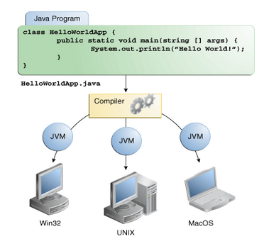
Platform-independent
Because the Java VM is available on many different operating systems, the same .class files are capable of running on Windows, Linux, Mac OS ...

Slide 6
First steps in Java
Installing JDK
Installing Eclipse IDE (www.eclipse.org)
My first class
  All java classes start with capital letter
  Classes' names do not include spaces
  Each class is a file. File and class name are the same
  .class and .java
  Java is case sensitive

Slide 7
My first program
main method – entry point for each java program
System.out.println();
HelloWorld program
What is console?
public class HelloWorld {
public static void main(String[] args) {
System.out.println("Hello World");
}
}

Slide 8
Variables
Variables in java
  It's purpose is to hold information
  Have an unique name
  Have a type
  Have a value (can be changed)
Declaring variable
type
name
value
int sum = 10;

Slide 9
Primitive types in Java
Primitives are basic java type
Primitives can be used with basic operations
Primitives' values can be assigned to variables
Primitive types in java
  byte, short, int, long
  float, double
  boolean
  char

Slide 10
Numeric types
Numeric types are byte, short, long, int, double, float
byte – 8b (-128 : 127)
  byte b = 100;
short – 16b (-32768 : 32767 )
  short s = 10000;
int – from integer, 32b
  int i = 10000;

Slide 11
Numeric types
long – 64b
  long l = 100;
  l is added as a sufix to indicate long type
float - precision to 32b
  float f = 3.14f;
  f is added as a sufix to indicate float type
double – precision to 64b
  double d= 3.14;

Slide 12
char and boolean
char is used for 16b unicode character
  Char values are embedded in ''
  char ch = 'c';
boolean has two values - true or false
  boolean bool = false;

Slide 13
Primitives' default values
Data type
byte
short
int
long
float
double
char
boolean
Default value
0
0
0
0
0.0
0.0
'\u0000'
false

Slide 14
Other data types
Strings
Reference types
We'll talk about them later in the course!

Slide 15
Operators
Aritmetic +, -, *, /, %
Logical &&, ||
Assignment =, +=,-=, *=, /=
Equality ==, !=
Differences between / and %
Try using some of them and print the result in console

Slide 16
Reading from console
Using Scanner
Read user input with sc.nextXXX();
Scanner sc = new Scanner(System.in);
sc.nextInt();
sc.nextDouble();
sc.nextLong();

Slide 17
Control flow
Control flow is the way a program goes – execution of predifined statements
Control flow may differ each time in dependance of conditions – either input data, or predifined conditions by the programer(i.e – time and so on)
During the program execution decisions are being met – the program flow branches

Slide 18
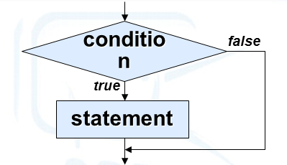
if-else statement
If (condition) {
  statement
}
if (condition) {
executionA
} else {
  executionB
}

Slide 19
if-else statement
If can exist without else
But
Else can't exist without if
Nested if-else statement
double a = 7.5;
if (a < 0) {
System.out.println("a is smaller than 0");
} else {
if (a == 0) {
System.out.println("a is 0");
} else {
System.out.println("a is bigger than 0");
}
}

Slide 20
Conditional Statement
• Logical NOT !
• Logical AND &&
• Logical OR ||
A | B | A || B | A && B | ! A
false | false | false | false | true
true | false | True | false | false
false | true | true | false | true
true | true | true | true | false

Slide 21
Blocks
A block is a group of zero or more statements between balanced braces and can be used anywhere a single statement is allowed
Always format your code! Do not write code like this:
if (a > 10) {
System.out.println("a is " + a);
System.out.println("a is bigger than 10");
} else {
System.out.println("a is not bigger than 10");
}
if (a > 10) {
System.out.println("a is " + a);
System.out.println("a is bigger than 10");}
else {System.out.println("a is not bigger than 10");
}

Slide 22
Mistake
int a = 7;
if (a > 10); {
System.out.println("a is " + a);
System.out.println("a is bigger than 10");
}
In this case println statements will be executed no matter the condition!
int a = 7;
if (a > 10);
{
System.out.println("a is " + a);
System.out.println("a is bigger than 10");
}

Slide 23
Summary
Startup
Variables
Primitive types
Operators
Working with the console
If-else statement and blocks

